Slide 1
PRACTICE SCHOOL - 1
END Semester Presentation
Developing Data-Driven Dashboards: From Concept to KPI Execution
SUYASH MANGLA (2023A70593P)

Slide 2
Company & Project
IIC (INK IN CAPS) is a Mumbai-based full-service MarTech agency specializing in designing scalable experiential marketing campaigns.
I am working on a Business Insights Dashboard project at IIC Interactive Labs under the mentorship of Ms. Divya Jain, where I have developed multiple interactive, data-driven visualizations using Power BI to analyze company performance data.
In the later phase of the project, I transitioned to Google Looker Studio to overcome platform limitations and apply advanced dashboard design principles for enhanced interactivity, storytelling, and stakeholder usability.

Slide 3
OVERVIEW
Gained practical experience in data modeling, data transformation, and DAX functions using Power BI.
I successfully created three interactive dashboards using the web version of Power BI, focusing on visualizing key performance metrics such as revenue, departmental performance, regional distribution, and project-based analysis.
Added features like slicers, filters, tooltips, and consistent color-coded themes.
Focused on KPI tracking, monthly trends, product segmentation, and regional contributions.
Shifted to Google Looker Studio due to macOS limitations on Power BI Web.

Slide 4
Looker Studio: Key Learnings & Implementation
Mastered Data Integration: Connected multiple data sources like Google Analytics, Search Console, and Facebook Ads via Supermetrics to enable unified reporting in a single dashboard.
Applied BI Concepts & Advanced Features: Utilized dimensions, metrics, data blending, custom fields, and conditional formatting to create insightful, cross-platform visualizations.
Enhanced Interactivity & Navigation: Designed drill-down reports with filters, date range controls, and community visualizations to enrich user engagement and functionality.
User-Centric Dashboard Design: Developed clean, multi-page dashboards with intuitive layouts and storytelling aligned with business objectives.

Slide 5
Dashboard Design Principles: Key Takeaways
Focused on creating dashboards that go beyond basic visuals by applying design principles like visual hierarchy, logical layout, and user-centric storytelling to ensure clarity and insight delivery.
Redesigned earlier dashboards by grouping related metrics, placing key KPIs at the top, and using consistent color schemes—resulting in better readability, cleaner navigation, and improved decision-enablement.
Drew inspiration from real-world dashboards and industry templates to refine structure, layout, and segmentation, ensuring that the final dashboards aligned with stakeholder needs and analytical goals.

Slide 6
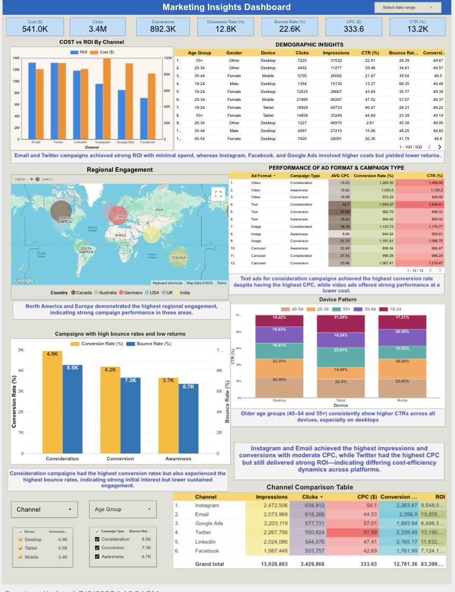
Dashboard Walkthrough
Sections :
Channel Performance Overview: ROI Leaders & Laggards.
Geographic Hotspots of User Activity.
Optimizing Ad Strategy by Device and Format.
Evaluating Campaign Effectiveness Across Channels.

Slide 7
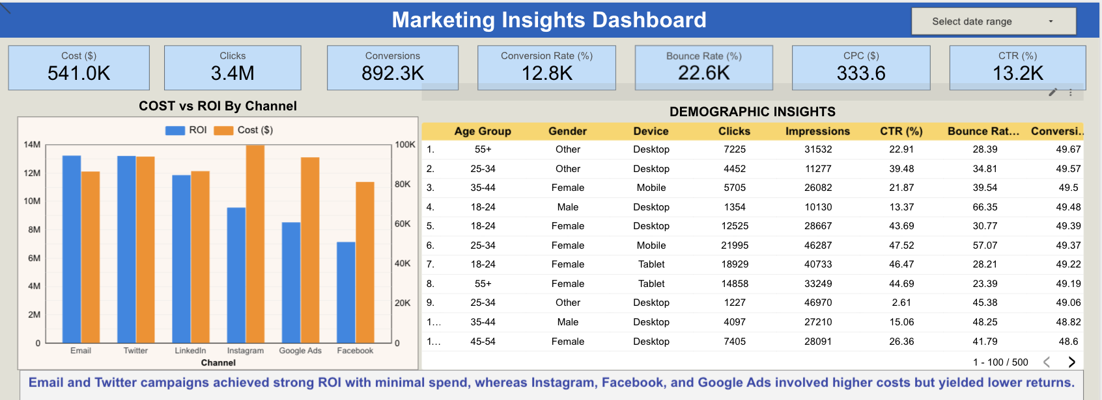
Channel Performance Overview: ROI Leaders & Laggards
Best ROI Channels are Email and Twitter with High ROI with lower costs.
Underperforming Channels are Instagram, Facebook, Google Ads having High spends but low returns.
Users aged 18–24 achieved the highest click-through rates, while female audiences demonstrated greater overall engagement across channels.

Slide 8
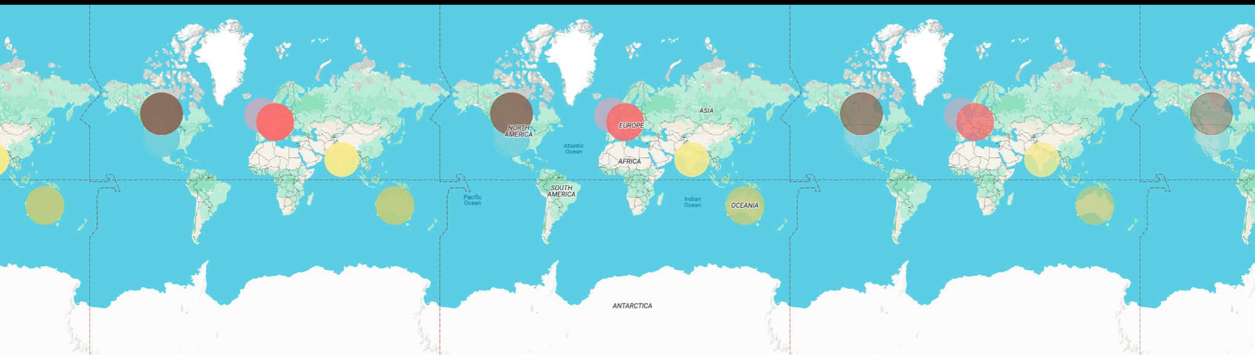
Geographic Hotspots of User Activity
This Map shows the conversion rate metrics all over the world.
Audience engagement was strongest in North America and Europe, indicating high regional performance and valuable market opportunities.

Slide 9
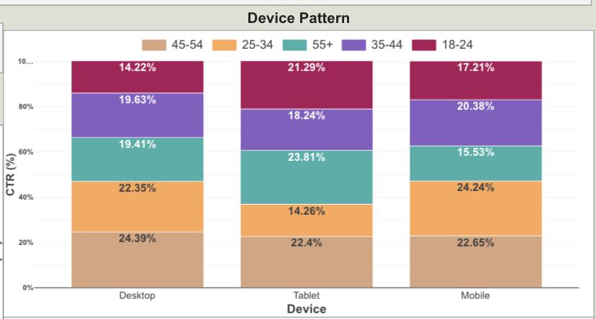
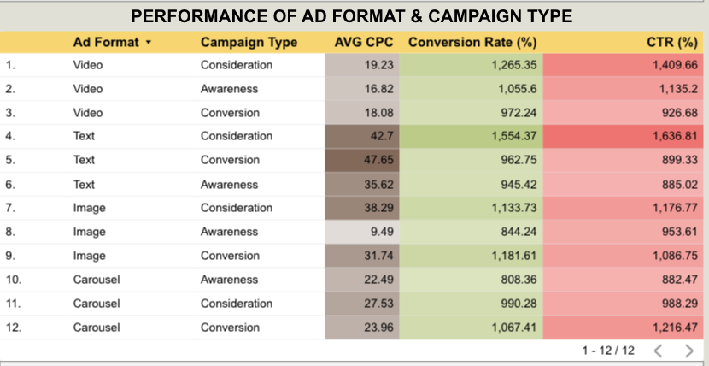
Optimizing Ad Strategy by Device & Format
Older age groups (45–54 and 55+) consistently show higher CTRs across all devices, especially on desktops.
Text-based Consideration campaigns emerged as top performers, recording the highest CTR (1,836.8), Conversion Rate (1,554.4), and CPC (42.7).
Image-based campaigns delivered lower performance overall, despite benefiting from a lower CPC.

Slide 10
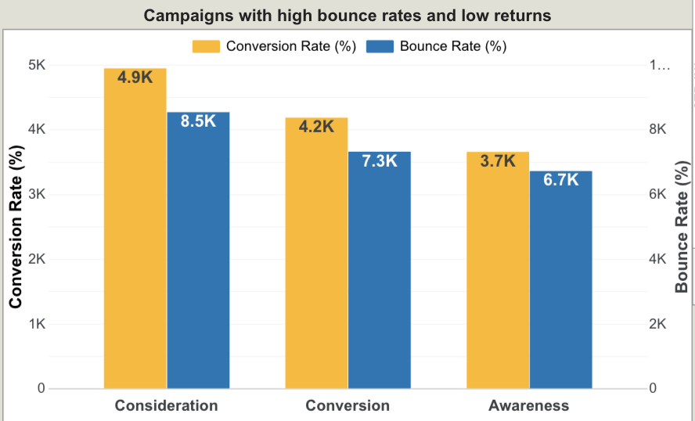
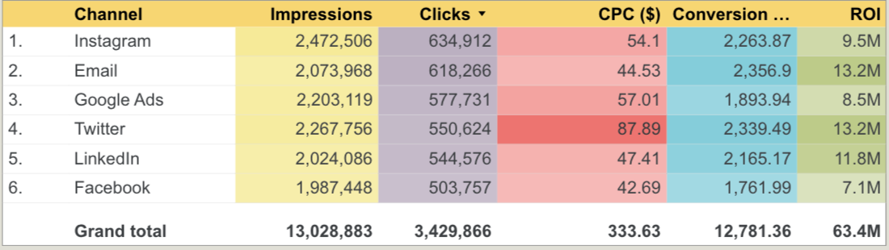
Evaluating Campaign Effectiveness Across Channels
Consideration campaigns had the highest conversion rates but also experienced the highest bounce rates, indicating strong initial interest but lower sustained engagement.
Instagram and Email achieved the highest impressions and conversions with moderate CPC, while Twitter had the highest CPC but still delivered strong ROI—indicating differing cost-efficiency dynamics across platforms.

Slide 11
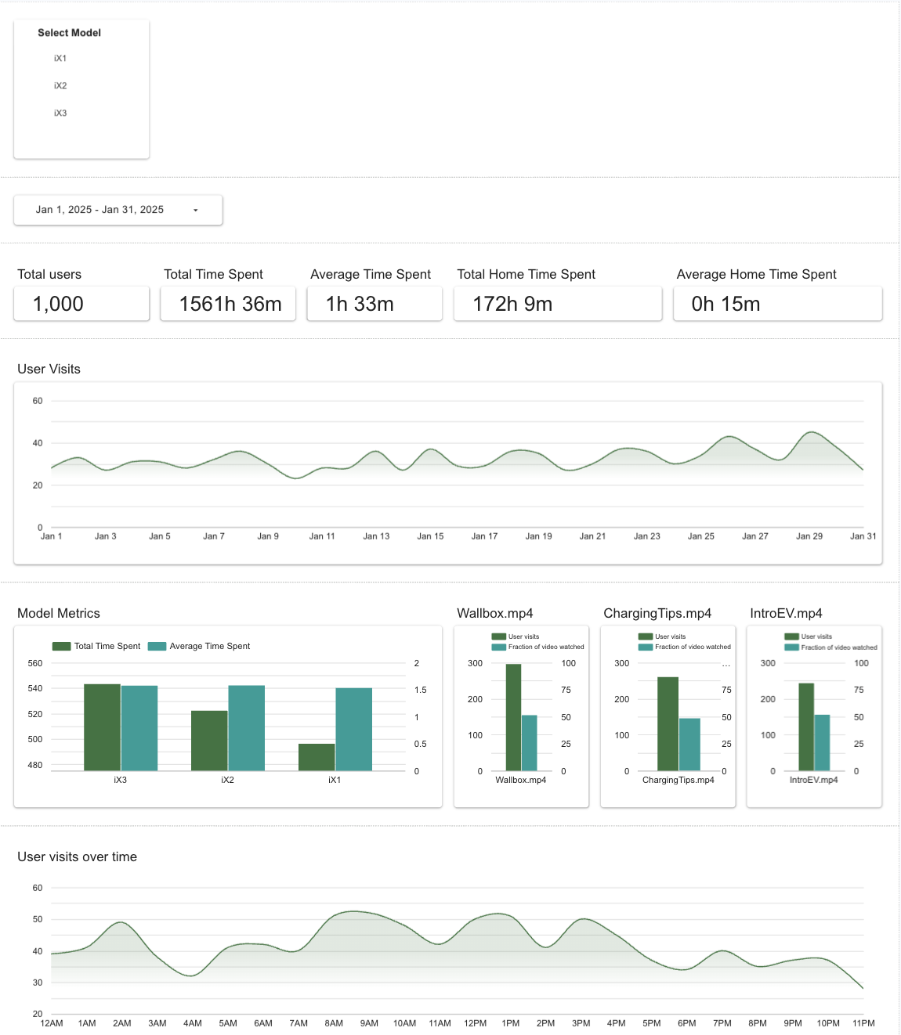
BMW Marketing & Performance Dashboard
The BMW Dashboard uses production-level data to reveal insights on user engagement, EV model preferences, and video interactions.
Key KPIs like total users, time spent, and content views (iX1–iX3, Wallbox, Charging Tips, IntroEV) are visualized through bar charts and interactive filters by model, time, and content.

Slide 12
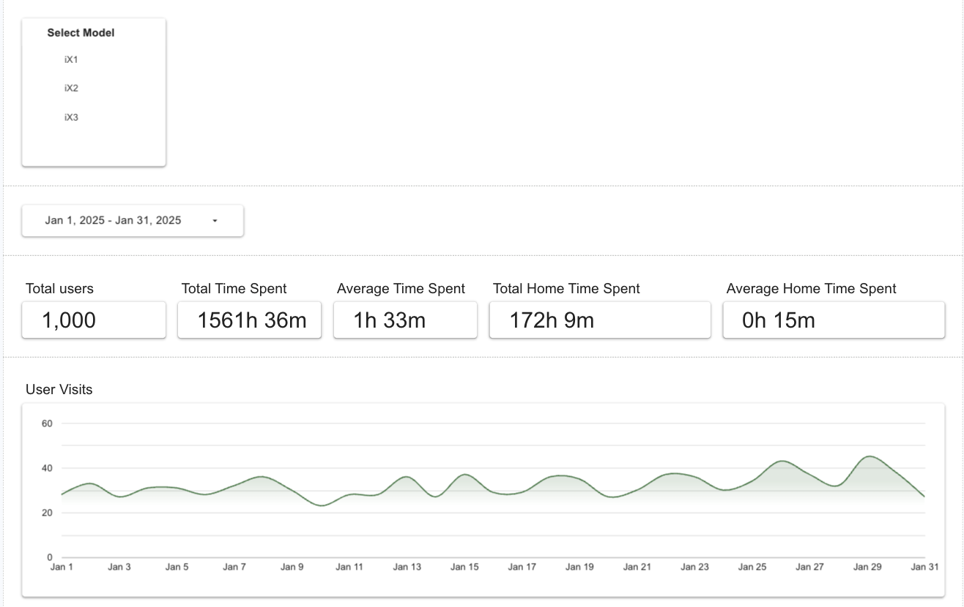
User Engagement & Model-Based Interaction Insights
User Engagement Metrics: The dashboard recorded 1,000 total users with a cumulative time spent of 1561 hours, averaging 1 hour 33 minutes per user, highlighting strong engagement.
Home Interaction Insights: Despite high total usage, home time spent was only 172 hours, indicating limited user interaction from home environments (average home time: 15 minutes).
Model-Based Filtering: The dashboard features model-wise filters (iX1, iX2, iX3) and visualizes daily visit trends, enabling granular insights into user behavior across models and time.

Slide 13
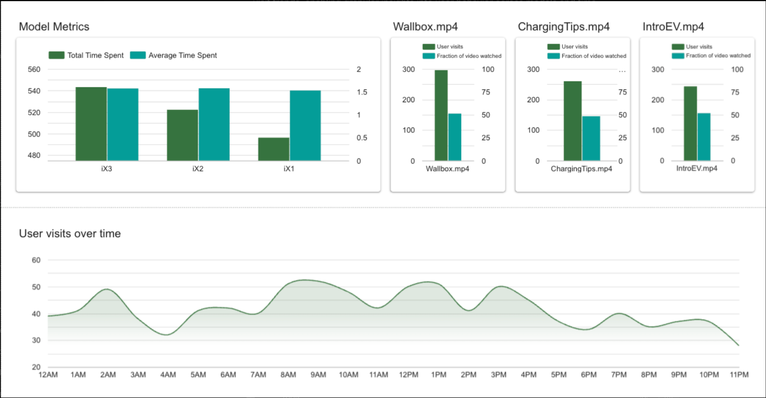
EV Model Engagement & Video Insights
Model Engagement: Among the EV models, iX3 had the highest total time spent, while iX2 recorded the highest average time per user, indicating deeper engagement despite fewer total views.
Video Content Interaction: All three videos — Wallbox, Charging Tips, and IntroEV — received over 250 visits, but only ~50% of each video was watched on average, highlighting a potential drop-off in attention span.
Peak Usage Hours: Peak user activity seen at 2 AM, 8 AM, 1 PM, and 6 PM.

Slide 14
Conclusion
The dashboard offered a comprehensive view of campaign and user behavior across channels, devices, regions, models, and content formats.
Marketing dashboard:
Email and Twitter were most ROI-efficient; Instagram and Facebook underperformed despite higher spends.
North America and Europe led in engagement, indicating regional resonance.
Text-based campaigns outperformed image-based ads in cost efficiency and ROI.
BMW Dashboard :
Among EV models, iX3 had the highest total time spent, while iX2 showed deeper per-user engagement.
Videos received over 250 views each, but only ~50% was watched, signaling potential drop-off.
Peak user activity was observed at 2 AM, 8 AM, 1 PM, and 6 PM, aiding optimal content timing.
These insights enable marketing teams to refine targeting, optimize spend, and enhance content strategy

Slide 15
THANK YOU!

